Slide 1
optics

Slide 2


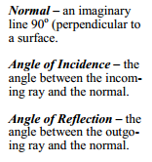
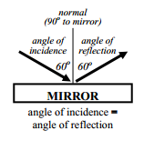

Slide 3
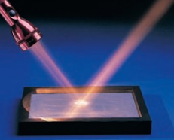
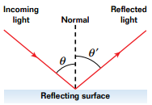
reflection
The symmetry of reflected light is described by the law of reflection, which states that the angles of the incoming and reflected rays are equal

Slide 4
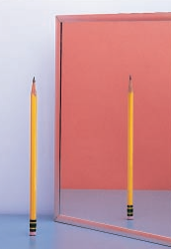
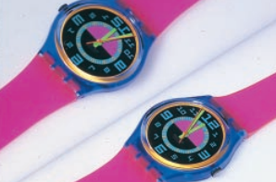
The right side of an object becomes the left side of its image.
However the top and bottom of an object will still be the same

Slide 5


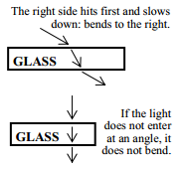
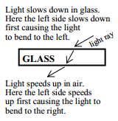
refraction

Slide 6



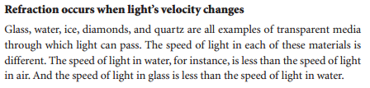
refraction

Slide 7
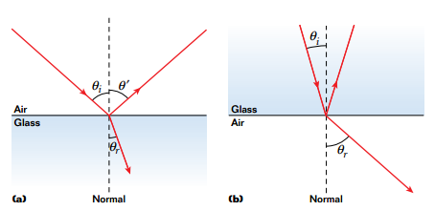
refraction
When light moves from a material in which its speed is higher to a material
in which its speed is lower, such as from air to glass, the ray is bent toward the
normal
If the ray moves from a material in which its speed is lower to one in which its speed is higher, the
ray is bent away from the normal.

Slide 8
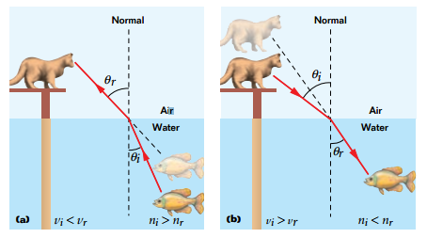
Refraction
(a)To the cat on the pier, the fish looks closer to the surface than it
really is.(b) To the fish, the cat seems to be farther from the surface
than it actually is.

Slide 9
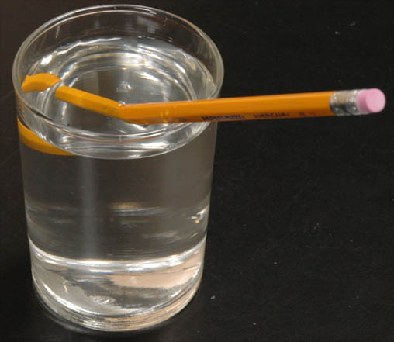
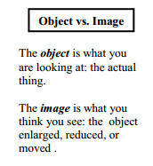

Slide 10
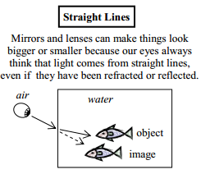

Slide 11
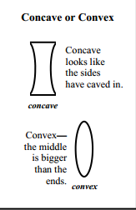
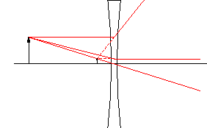
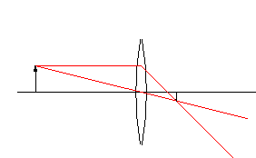
Concave vs. convex

Slide 12
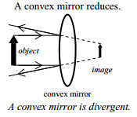
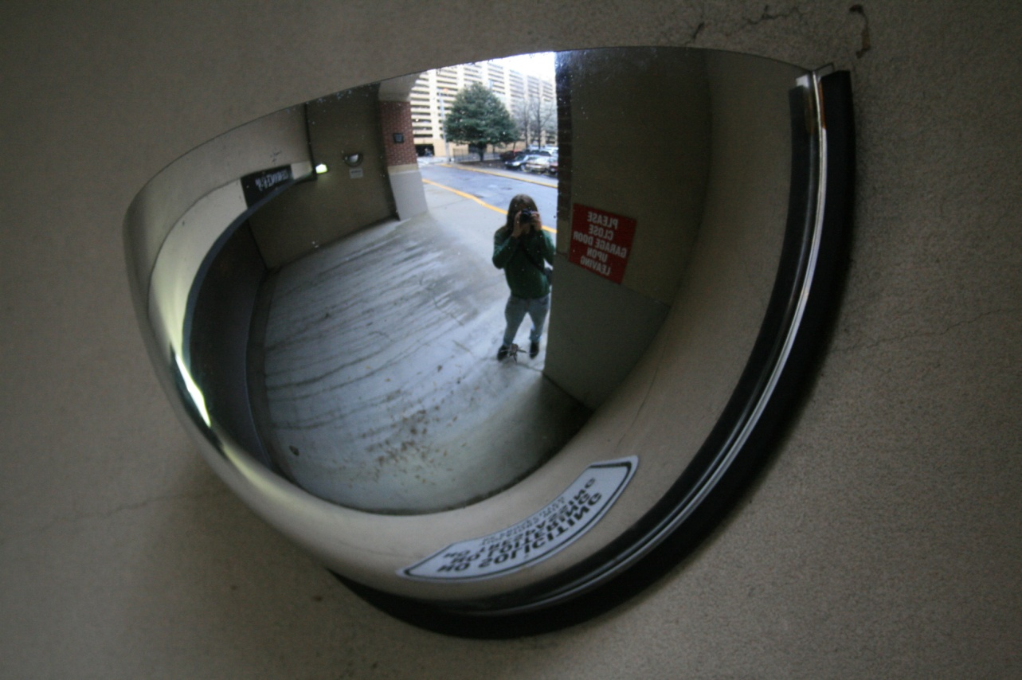
Convex mirror

Slide 13
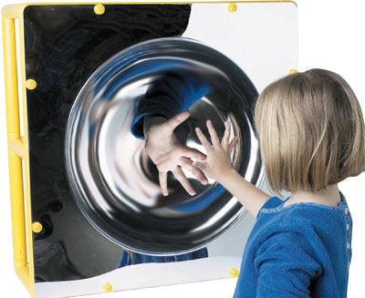
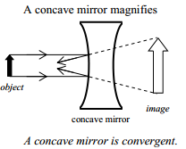
Concave mirror

Slide 14
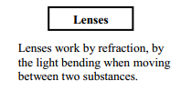

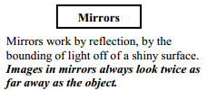
Lenses vs mirrors

Slide 15
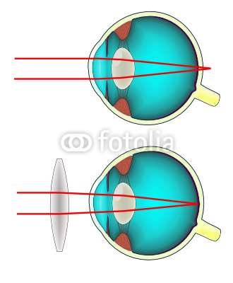
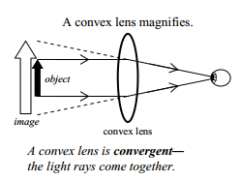
Convex lens
Far-sightedness Hyperopic eye

Slide 16
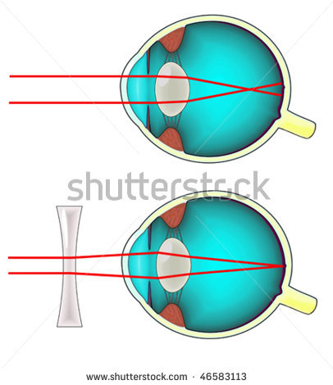
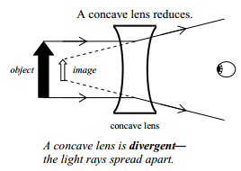
Concave lens
Near-sightedness
Myopic eye

